Slide 1
OLA Ride Insights
Ride-Sharing & Mobility Analytics
Presented By : Gowtham

Slide 2
Agenda
Project Overview
Dataset & Scope
Visualization Highlights
Insight & Observations
Technical Highlights
Conclusion

Slide 3


Ola Ride Insights
This project aims to analyze and visualize of ride information
This Photo by Unknown Author is licensed under CC BY-NC-ND

Slide 4
Project Overview
Objective
Analyze the booking trends, ride cancellations, payment methods, and customer behaviour.
Technology Used
Python, SQL, Excel, Streamlit, Pandas, babel, sqlalchemy, dotenv, urllib,Power BI
Data Source
Ola Rides Data set in Excel format
Key Functions
ETL processing of data cleaning activity of ride transaction datasset
Visualizaton of Ride revenue,rating, booking status and cancellation
Interactive dashboard creation using Streamlit and matplotlib and seaborn

Slide 5

Dataset & Scope
Collecting the data from the official data source provider and visualize the growth patterns over the year and quarters

Slide 6
Dataset & Scope
Data Categories
The single data set provide all kind of information in the tabular format
Sources
Scope
Data from excel sheet
Analyze the data , identify the ride information and build an interactive Streamlit dashboard
Structure
File Format
Rows and columns in the single data set
Excel format

Slide 7


Visualization Highlights
Understanding the Rider information, rating and cancellation analysis.

Slide 8
Visualization Highlights
Visualized Booking information based on the Booking status
Bar chart showing booking value of based on payment method
Pie chart showing the category wise cancellation details
Provide the filter option in POWER BI to filter the transactions based on the date

Slide 9

Insights & Observations
Booking Status, Cancellation reason, Payment method and understand the customer and driver ratings.

Slide 10
Insights & Observations
Booking Information, Success Booking Information & Status wise Booking status
Average Booking rides, Top 5 customer details based on rides
Minimum, Maximum and average rating provide by customer and driver.
Driver cancellation, customer cancellation reason and data display in the bar chart based on values, Cancelled ride count by customer and driver and incomplete ride information
Total booking value, payment method wise booking values split up, Top 5 Customer details based on booking values.

Slide 11


Technical Highlights
Discuss about the data sourcing, used libraries and visualization tool

Slide 12
Technical Highlights
Data Source – Ola Ride Dataset
Data Handling: Cleaned, transformed, to MySQL using Python (Pandas)
Visualization: Created dynamic charts with Seaborn and Matplotlib
Dashboard: Built an interactive Streamlit web app for user-driven analysis
Power BI : Build an interactive app using Power BI with Date filter option

Slide 13
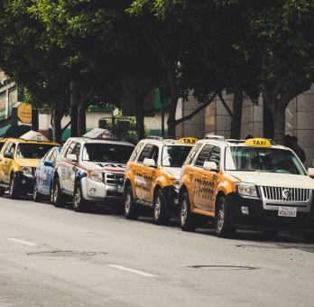
Conclusion
This project provides a comprehensive view of ola rider behaviour base on the ola ride dataset

Slide 14
Conclusion
The project successfully analyzed Ola rider informations
Identified top-customers & most used payment method
Created interactive visualizations for detailed exploration
Observed growth in bookings, cancellation analysis, Rating and Revenue
Provided Insights useful for business, customers and drivers
The application launched successfully in the Render
Link - https://olaride-insight.onrender.com/

Slide 15
Thank You

